Slide 1
Server-Side Rendering
Overview of SSR
Example application

Slide 2
1. Overview of SSR
A reminder about SEO
The problems of React and SEO
The solution to the problem

Slide 3

A Reminder about SEO
According to Wiki:
Search engine optimization (SEO) is the process of affecting the visibility of a website or a web page in a web search engine's unpaid results.
In general, the earlier (or higher ranked on the search results page), and more frequently a site appears in the search results list, the more visitors it will receive from the search engine's users; these visitors can then be converted into customers.
3

Slide 4
The Problems of React and SEO
React apps are not search engine friendly...
If you view the page source for index.html in a regular React app, it just shows the <div> element:
React replaces this placeholder with your content, but…
There's no hook to tell search engine robots about this
So search engines never get to see the final page content
So they can't crawl your page and index your content!
<div id="root"></div>
4

Slide 5
The Solution to the Problem
To solve the problem on the previous slide…
React apps must be rendered (to HTML) on the server
So by the time it gets to the browser, it's "normal" HTML
So search engines can crawl into the real content
This is "server-side rendering" (SSR)
We'll show a simple SSR solution to give you an idea of the principles involved
5

Slide 6
2. Example Application
Overview
Provisioning a web server
Facilitating server-side transpilation
Implementing a server app
Hydrating the SSR app at the client
Building the application
Running the application

Slide 7
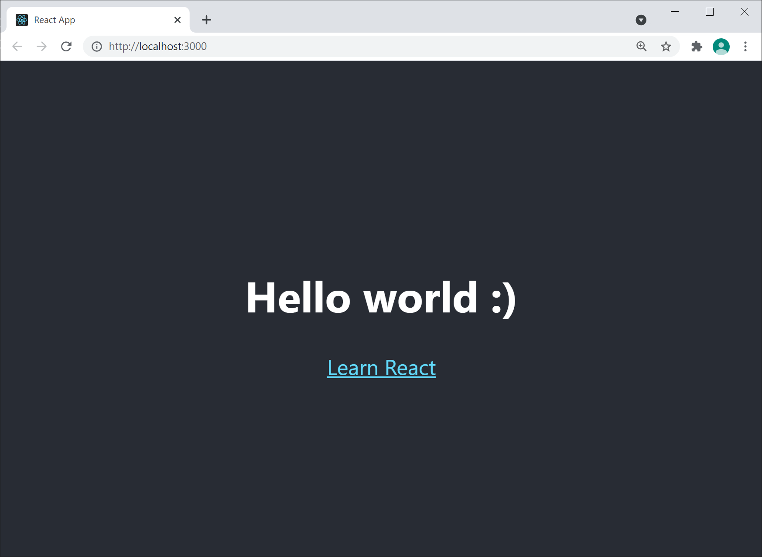
Overview
For the purposes of demonstration, we've created a simple demo app using "Create React App"
See demo-app folder, you can run at client as normal:
What do you see when you "view source" in the browser?
npm start
7

Slide 8
Provisioning a Web Server
Let's now think about how we can render the app at the server, using SSR
The first step is to provision a web server
We'll use Node.js and Express
You can install as follows:
npm install -g express
8

Slide 9
Facilitating Server-Side Transpilation
Shortly we'll see how to implement a Node.js server app, to render our React code at the server
The Node.js app will use the "React server" API to do this
Unfortunately, Node.js doesn't understand JSX or ES6…
So we'll need to install Babel at the server, to transpile JSX and ES6 into regular JS
npm install --save @babel/register @babel/preset-env @babel/preset-react
npm install --save ignore-styles
9

Slide 10
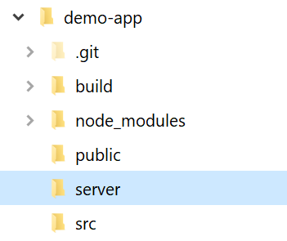

Implementing a Server App (1 of 3)
Now we're ready to implement a Node.js server app
Listens for incoming requests for our React app
Serves-up build/index.html
We've created a server sub-folder
index.js is server entry point
server.js holds HTTP logic
10

Slide 11
Implementing a Server App (2 of 3)
Take a look at server/index.js
Pulls in the Babel transpiler at the server
This is necessary, transpiles server-side React code to JS
require('ignore-styles')
require('@babel/register')({
ignore: [/(node_modules)/],
presets: ['@babel/preset-env', '@babel/preset-react']
})
require('./server')
server/index.js
11

Slide 12
Implementing a Server App (3 of 3)
Now take a look at server/server.js
Listens on port 8080, serves up build/index.html
Notice the following key statement
Uses the React-DOM server API to render our <App/> component as a string at the server - this is SSR!
data.replace(
'<div id="root"></div>',
`<div id="root">${ReactDOMServer.renderToString(<App />)}</div>`
)
…
server/server.js
12

Slide 13
Hydrating the SSR App at the Client
The final step is to tweak the React app source code in src/index.js
Change this:
To this:
Explanation: The client doesn't need to "render" the app component (it's already been rendered at server)
The client just has to "re-hydrate" it
ReactDOM.render(…);
ReactDOM.hydrate(…);
13

Slide 14
Building the Application
We're now ready to build the React app
This creates an optimized production build
See the build folder
Take a look at build/index.html
This is the home page of the app
This is what the Node.js app will serve up
npm run build
14

Slide 15
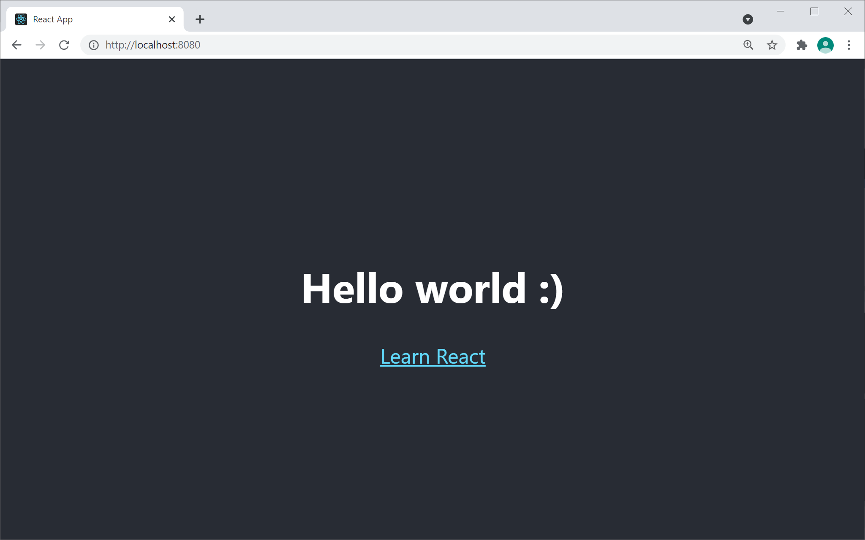
Running the Application
Run the Node.js server app as follows:
Now browse to http://localhost:8080
Returns the SSR React app
Try View Page Source now
node server/index.js
15

Slide 16
Summary
Overview of SSR
Example application

